Slide 1
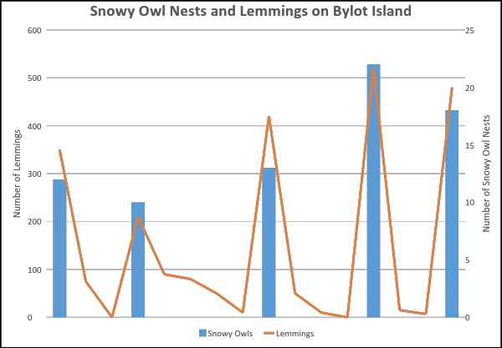
Name ________________________
Lemmings and Snowy Owls
Observations | Questions

Slide 2
What patterns do you see on the graph?
How would you explain these patterns?
What would explain the years when there were no snowy owl nests on Bylot island?
Explain the pattern of the prey/predator relationship between snowy owls and lemmings.

