Slide 1
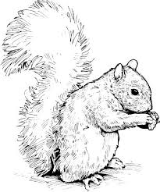
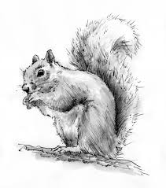
Squirrel Skirmish
Year | Red Squirrels (Native) | Gray Squirrels (Invasive) | Coyotes (Predator)
1 | 130 | 0 | 10
2 | 146 | 0 | 20
3 | 150 | 0 | 28
4 | 126 | 0 | 34
5 | 114 | 0 | 24
6 | 128 | 0 | 32
7 | 125 | 0 | 30
8 | 98 | 6 | 38
9 | 88 | 10 | 18
10 | 62 | 20 | 16
11 | 69 | 36 | 18
12 | 45 | 64 | 12
13 | 43 | 102 | 12
14 | 20 | 144 | 14
15 | 31 | 156 | 10
16 | 16 | 164 | 8
17 | 4 | 186 | 12
18 | 6 | 162 | 6
19 | 4 | 174 | 6
20 | 0 | 178 | 4

Slide 2
Red squirrels and gray squirrels are two different species. They both live in trees and eat the same types of food. When they come into contact, they begin to compete for resources. The gray squirrel is larger with a length of 23–30 cm compared to red squirrels, which average 19–23 cm long. Gray squirrels are a highly adaptive species. They quickly learn to live in new habitats. They are stronger and faster than red squirrels. The coyote is a natural predator of tree squirrels.
1. What patterns do you see on the graph between the two squirrel species? How does this new information help explain these patterns? How does competition between native squirrels and invasive squirrels affect population size?
____________________________________________________________________________________________________________________________________________________________________________________________________________________________
2. What happened to the number of coyotes as the populations of squirrels changed? How is a predator population affected by the availability of prey?
____________________________________________________________________________________________________________________________________________________________________________________________________________________________
3. What would you expect to happen to a new population of red squirrels if gray squirrels were introduced into the ecosystem?
_____________________________________________________________________________________________________________________________________________________________________

