Slide 1
6th Grade Strand 4
Great Salt Lake: A Changing Lake - Teacher Slides

Slide 2
Great Salt Lake: A Changing Lake - Standards
6.4.5 Evaluate competing design solutions for preserving ecosystem services that protect resources and biodiversity based on how well the solutions maintain stability within the ecosystem. Emphasize obtaining, evaluating, and communicating information of differing design solutions. Examples could include policies affecting ecosystems, responding to invasive species or solutions for the preservation of ecosystem resources specific to Utah, such as air and water quality and prevention of soil erosion.

Slide 3
Great Salt Lake Ecosystem Lesson Timeframe
Day 1: Engage with a shrinking lake
Day 2 (with follow up observations): Explore the causes of the shrinking lake with an article and lake model
Day 3: Explain 1 the effects of the shrinking lake with the bird game
Day 4: Explain 2 the effects of the shrinking lake with research on ecosystem services
Day 5 - 6: Elaborate with evaluating projects to preserve the lake
Day 7: Evaluate with an argument for why we should not divert more water from GSL

Slide 4
6th Grade Strand 4
Great Salt Lake: A Changing Lake - Student Slides

Slide 5
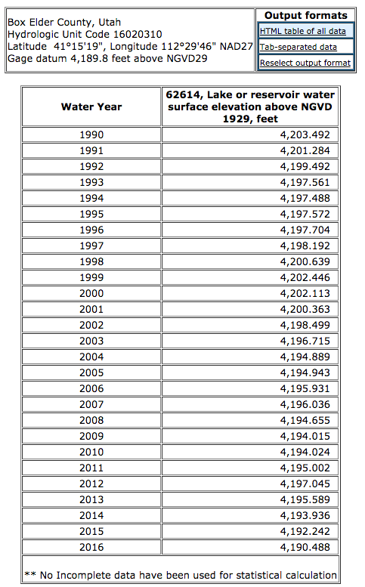
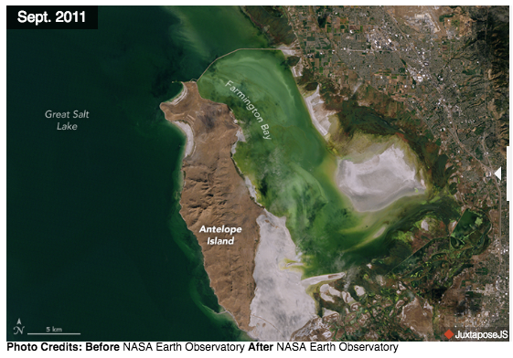
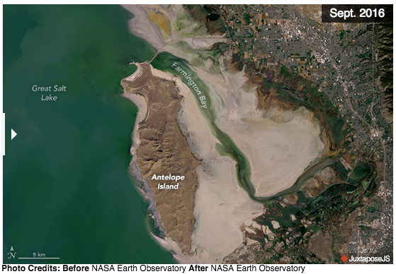
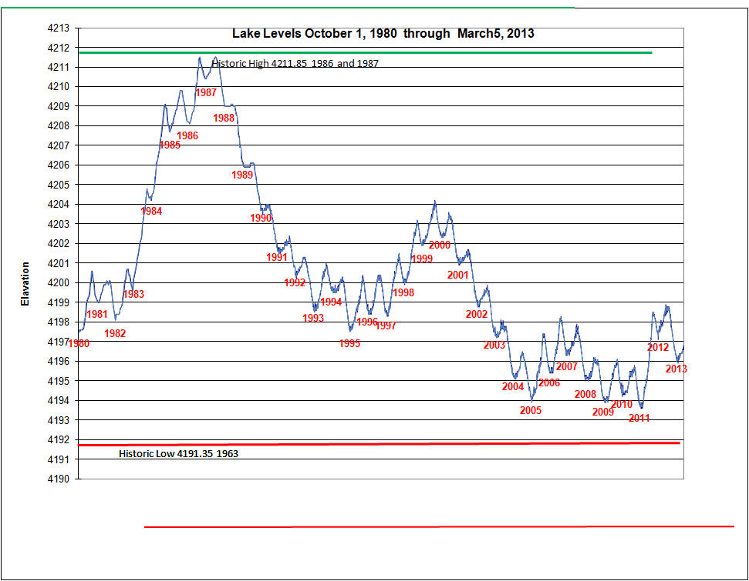
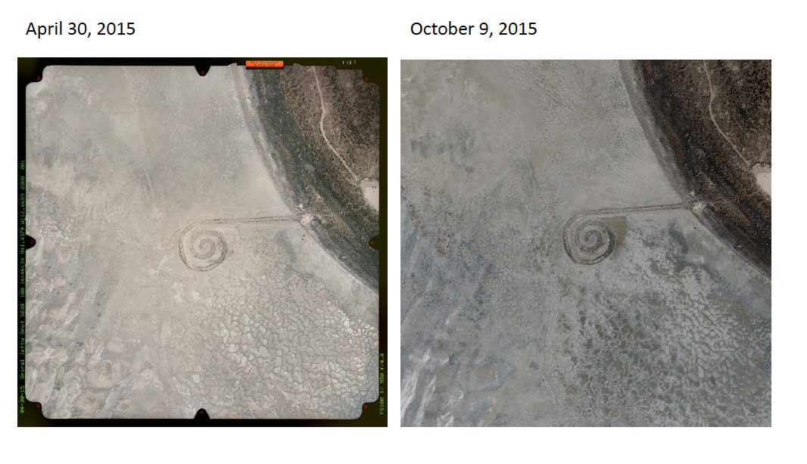
How is Great Salt Lake changing?
Analyze and discuss the data set on changes to Great Salt Lake.
Develop a claim about how GSL has changed. Support your claim using evidence from the data set.
Time lapse video

Slide 6
What is causing GSL to shrink?
Your task is to help to develop and then use a model to explain why the water levels in GSL are dropping.
Begin by reading the article, Is drought to blame for drop in Utah’s Great Salt Lake? Not likely. What factors are causing the drop in GSL’s water level?
Develop a model: How can you use a petri dish to model changes in GSL’s water level? How much water will you start with? What should the salinity of the water be? Will you add water to the model? Will you remove water from the model?

Slide 7
How will a shrinking lake affect the organisms in GSL?
Play the GSL Bird Game by visiting all 4 stations with your group.
Begin with the normal lake level station card.
Read the background information out loud.
Take a bean. This represents your bird “life”.
Take turns rolling the dice and read the card to learn your fate.
If you survived, roll the dice a second time.
Fill in your data recording sheet. How many birds started at the station? How many survived? What happened to you?
Restart the game with new beans. Repeat steps 4 - 7 with the low lake level station card.

Slide 8
How will a shrinking lake affect the organisms in GSL?
Analysis Questions:
Review your data. What patterns do you notice?
How did the number of birds that survived differ between the normal lake level game and the low lake level game?
What caused birds to not survive during the low lake level game?
Pelicans:
Grebes:
Phalaropes:
Ducks:
How were other populations of organisms affected by the low lake levels?
Thinking about biodiversity: Biodiversity refers to the total number of different species in an area. How does lake level affect biodiversity at GSL? Provide an example to explain your thinking.

Slide 9
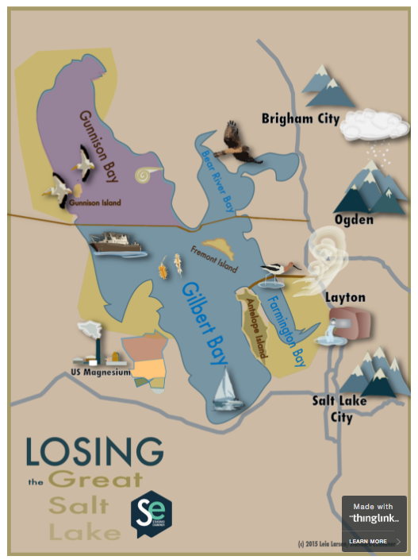
How will a shrinking lake affect humans?
Your task is to obtain and communicate information about GSL’s ecosystem services and how a shrinking lake will affect those services.
An ecosystem service is a positive benefit that an ecosystem provides to people. What ecosystem services do you think GSL provides to us?
Explore the Standard Net Interactive to learn more about GSL’s ecosystem services. You will then be assigned to research how lower water levels affect one of GSL’s ecosystem services and create a short summary to share with the class.

Slide 10
How will a shrinking lake affect humans?
In your science notebook create a chart to record how low lake levels affect ecosystem services.
Ecosystem Service | Effects of a Shrinking Lake
Outdoor recreation
Air quality
Brine shrimp harvest
Mineral extraction
Marina

Slide 11
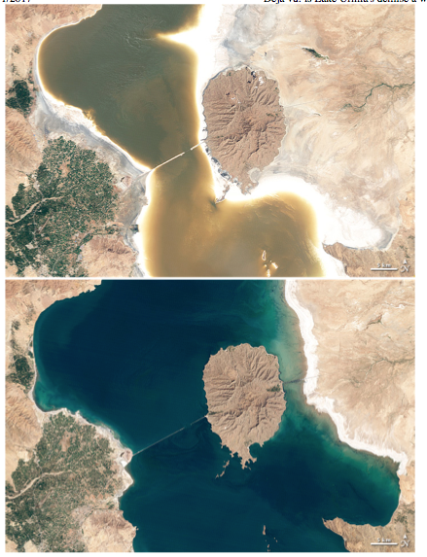
How can we protect GSL?
Lake Urmia is a salt lake in Iran. It has dropped to only 10% of its average size. The story of Lake Urmia serves as a caution to Utahns about what could happen if we allow the water level in Great Salt Lake to drop too far.
Read the article: Deja vu: is Lake Urmia’s demise a warning for Great Salt Lake? As you read, look for information about what could happen if GSL were to shrink to only 10% of its average size.

Slide 12
How can we protect GSL?
Many different groups in Utah monitor the GSL ecosystem to preserve biodiversity and/or ecosystem services. Your task will be to obtain and communicate information about one these different projects. You will present what you have learned to the class and listen to other’s presentations. Then you will evaluate the projects to determine which project you think is most important for preserving the GSL ecosystem.
Projects to Research:
Studying Pelicans on Gunnison Island (pelican cam)
Monitoring Brine Shrimp Populations
Preventing the Damming of Bear River
Studying Dust from GSL
Removing Phragmites from Wetlands
Preventing Avian Botulism (extra article)
Wetland Management
Questions to Research:
What are the goals of the project or study?
How will the project preserve biodiversity and/or ecosystem services?
Why is this project important for GSL?

Slide 13
GSL is shrinking, why should we care?
Work in a small group to fill in a cause and effect graphic organizer that summarizes the phenomenon: Great Salt Lake is shrinking.
Effect 1:
Great Salt Lake is shrinking.
Cause:
Effect 2:
Effect 3:
Effect 4:

Slide 14
GSL is shrinking, why should we care?
Your task is to write an argument for what we should do and why it is important to preserve the GSL ecosystem. Use the following prompt to prepare your written argument.
Your local representative from the Utah legislature is hosting a town hall meeting. One of the issues that will be discussed at the meeting is water use. Prepare an argument for why we should reduce the amount of water that is being diverted from GSL’s tributaries. Convince your legislator that allowing more freshwater to reach the lake is necessary for preserving the GSL ecosystem.
Be sure your argument has a claim, and that you provide evidence and reasoning based on what you have learned about GSL to support your claim.

