Slide 1
The Cold War
The period of time when there was extreme tension between democracies of the Western World and the communist countries of Eastern Europe

Slide 2
What is communism?
The idea that ALL property is owned by the government and people work and are paid according to their needs.
Many people have discovered that this system is filled with corrupt practices and selfish people. It has yet to work,
“Absolute power corrupts absolutely.” Lord Acton

Slide 3
Time Period
1945-1991
It began right after WWII when Communist Soviet Union had distrust with the rest of the allies. The Allies were concerned with the brutal leadership of Joseph Stalin and the spread of communism.

Slide 4
Causes of the Cold War
The east and the west had two very different views and they could not find a common ground
Fear of the other side taking away their way of life.
The secrecy of each side of the issue
Distrust in each other and the building up of military forces and ammunition.
Lack of Communication

Slide 5
Why did the United States get involved?
We saw that the distrust with the Soviet Union was growing as they distanced themselves from the western world.
The secrecy of the eastern word had the western world worried about what could happen.
The United States did not like the idea that people would not have freedom, we valued our freedom so the idea that others did not really bothered us.

Slide 6
Proxy Wars- how it was fought
While the United States and the Soviet Union did not fight against each other, the United States did fight against communism in the Korean and Vietnam wars to send a message that communism was wrong.
The Soviet Union fought in wars against democracy such as the Yom Kippur War and the Soviet Afghanistan War.
The US and the Soviet Union also fought in another way by demonstrating their power and technology. One example of this is the Space Race and another is the Arms Race.

Slide 7
Western Leaders
Harry Truman (US)
Dwight Eisenhower (US)
John F. Kennedy (US)
Lyndon B. Johnson (US)
Richard Nixon (US)
Ronald Reagan (US)
Margaret Thatcher (UK)

Slide 8
Communist Leaders
Joseph Stalin (USSR)
Leonid Brezhnev (USSR)
Mikhail Gorbachev (USSR)
Mao Zedong(China)
Fidel Castro (Cuba)

Slide 9
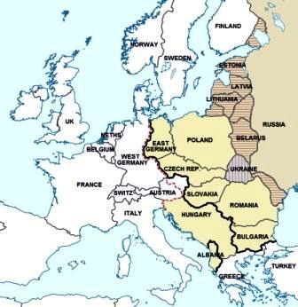
Map of the
Iron Curtain

Slide 10
The Red Scare
The Red Scare was the idea of fear based on what you thought the other side might do. We had created really terrible weapons such as the atomic bomb and we knew the other side had weapons just as deadly. The fear that they may use their weapons on us kept the people in constant fear.

Slide 11
Espionage
What exactly is this?
Espionage is the attempt to steal your opponents secrets. The CIA is the intelligence gathering part of the United States and the KGB is for the Soviet Union.
They gathered information in many ways. “Bugs” were invented for this purpose, stealing documents and intercepting communications along with sabotage and double-agents worked well.

Slide 12
How did this time period end?
The Korean War ended with a divided country to the North and South. In 2018, the two sides entered into conversations to end the division.
The Vietnam War ended with the entire country uniting under the Communist rule.
Conversations between the Soviet Union and the United States occurred when Mikhail Gorbachev and Ronald Reagan came into power. Reagan demanded that the wall in Germany be torn down during his “Tear Down this Wall” speech. The Berlin wall did come down in 1989.

Slide 13
What is the legacy of the Cold War?
The space program and the international space station.
Countries working together for the good of the world.
A Unified Europe, unified Germany
A trend for seeing similarities rather than differences

