Slide 1
SS5H4
U.S. Involvement in
World War I
& Post-War America
© 2014 Brain Wrinkles

Slide 2
Standards
Standard 4 Students will understand current global issues and their rights and responsibilities in the interconnected world
Analyze how major world events of the 20th century affect the world today.
Identify key events, ideas, and leaders of the 20th century (e.g. World War I, World War II, the Cold War, the Korean and Vietnamese conflicts, dynamic Asian economies).
Describe the impact of these events on the world today.
© 2014 Brain Wrinkles

Slide 3
SS5H4a
World
War I
© 2014 Brain Wrinkles

Slide 4
World War I
World War I began in 1914 with the assassination of Archduke Franz Ferdinand of Austria-Hungary.
The murderer was a Bosnian terrorist.
The archduke’s murder caused Austria-Hungary to declare war on Serbia.
© 2014 Brain Wrinkles

Slide 5
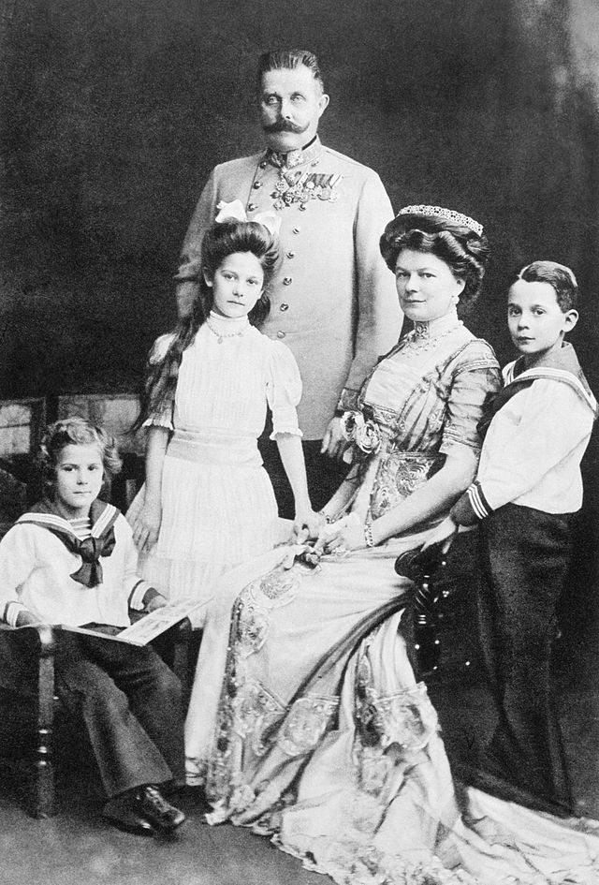
Archduke Franz Ferdinand with his Wife, Sophie, and 3 Children
1910
© 2014 Brain Wrinkles

Slide 6
Alliances
Military alliances made the conflict grow larger.
Russia came to Serbia’s aid.
Germany declared war on Russia and France.
Great Britain came to the aid of France by declaring war on Germany.
The Ottoman Empire entered the war a few months later.
Italy entered the war in 1915.
© 2014 Brain Wrinkles

Slide 7
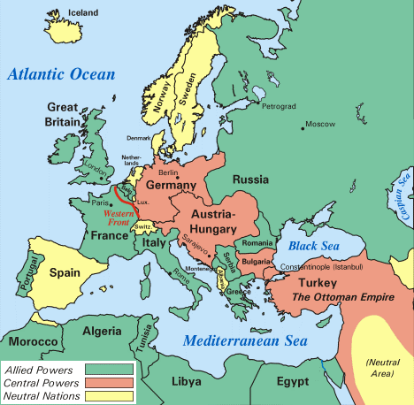
© 2014 Brain Wrinkles

Slide 8
Alliances
Allies | Central Powers
Serbia | Austria-Hungary
Russia | Germany
France | Ottoman Empire
Belgium | Bulgaria
Great Britain
Italy
© 2014 Brain Wrinkles

Slide 9
Isolationism
The US stayed out of the war at first.
President Woodrow Wilson thought that the US should remain neutral and that isolationism was the best option for the country.
However, the US did have a little involvement.
US merchant ships were sending food to devastated areas in Europe and helping block supplies from reaching Germany.
© 2014 Brain Wrinkles

Slide 10
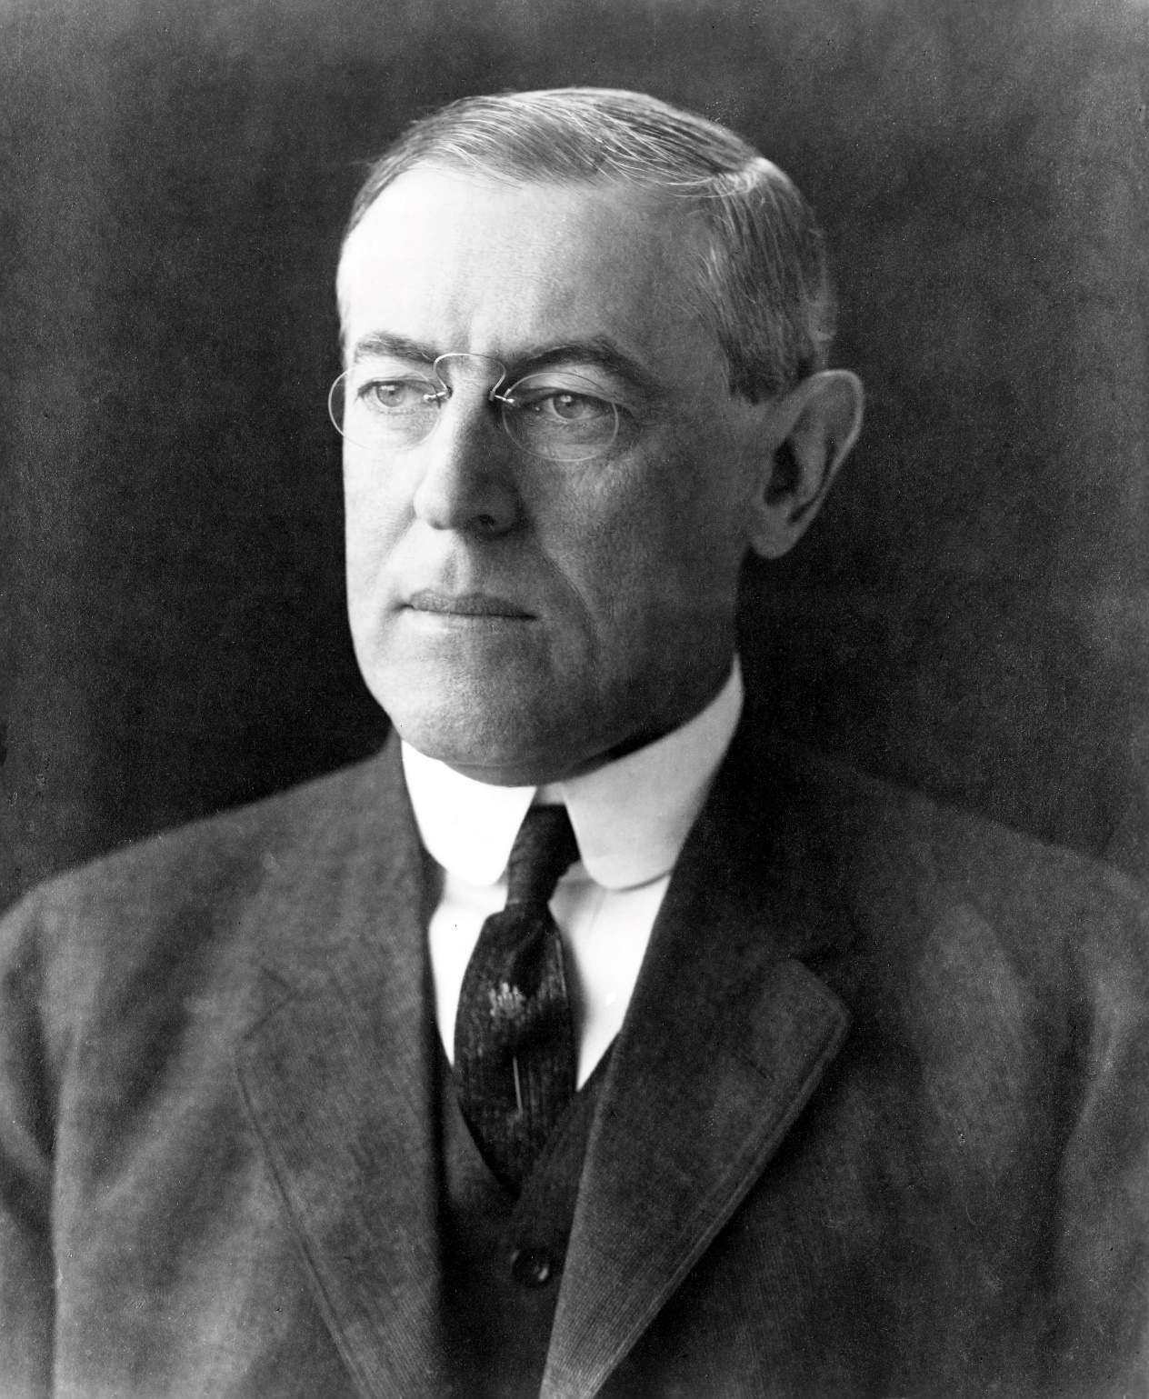
U.S. President Woodrow Wilson
© 2014 Brain Wrinkles

Slide 11
Lusitania
Things changed when Germany began using its submarines to sink ships in the Atlantic Ocean.
In May 1915, a German U-boat sank the British passenger liner Lusitania.
1,198 people died, including 128 Americans.
This angered many Americans and it went against the American belief of freedom of seas.
© 2014 Brain Wrinkles

Slide 12
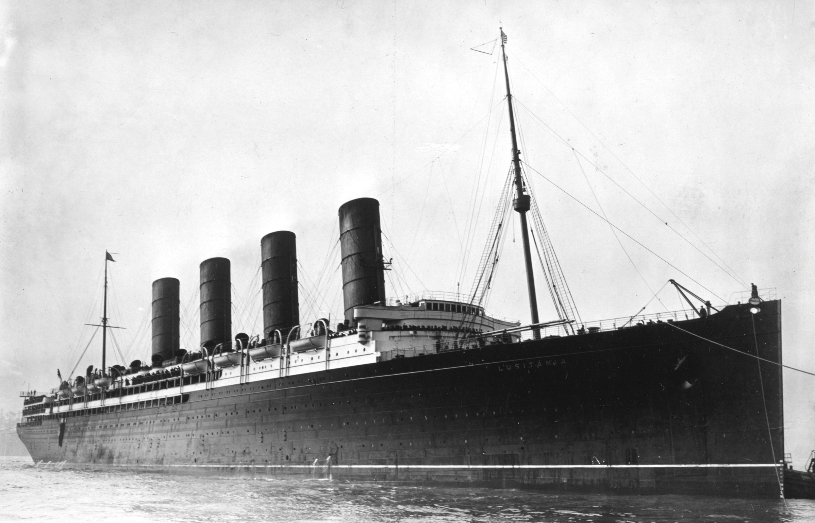
Lusitania 1907
© 2014 Brain Wrinkles

Slide 13
Sinking Ships
Germany continued to sink ships because they were trying to keep supplies from reaching Great Britain.
Americans sympathized with the Allies and were concerned about the safety of US ships.
The last straw was when several US ships were sunk in February and March 1917.
© 2014 Brain Wrinkles

Slide 14
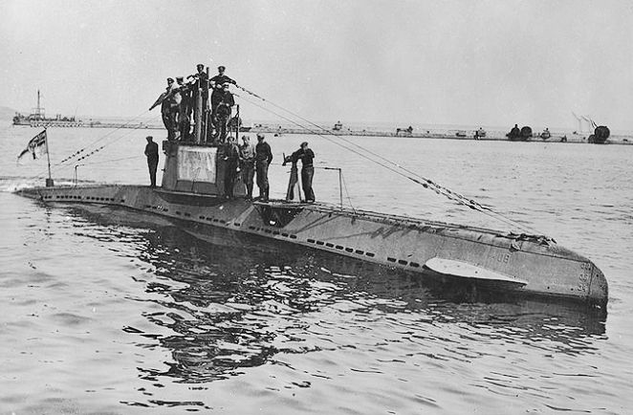
German U-boat
1910
© 2014 Brain Wrinkles

Slide 15
US Enters War
On April 6, 1917, the United States entered the was as an ally of Great Britain and France and declared war on Germany.
The US military drafted 4 million men and was sending thousands to Europe every day.
The US Navy sent supplies, Marines, and battleships to fight the Central Powers in Europe.
© 2014 Brain Wrinkles

Slide 16
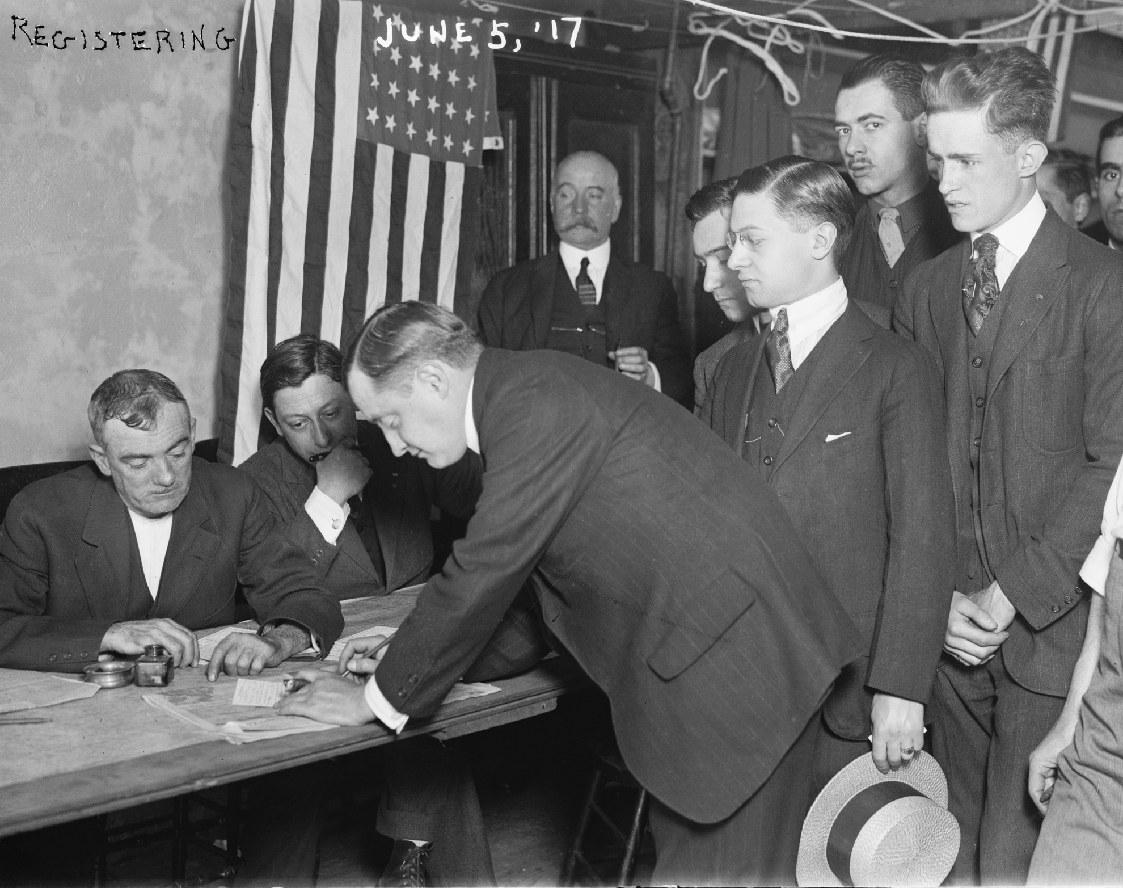
Young Men in NYC Registering for the Army
1917
© 2014 Brain Wrinkles

Slide 17
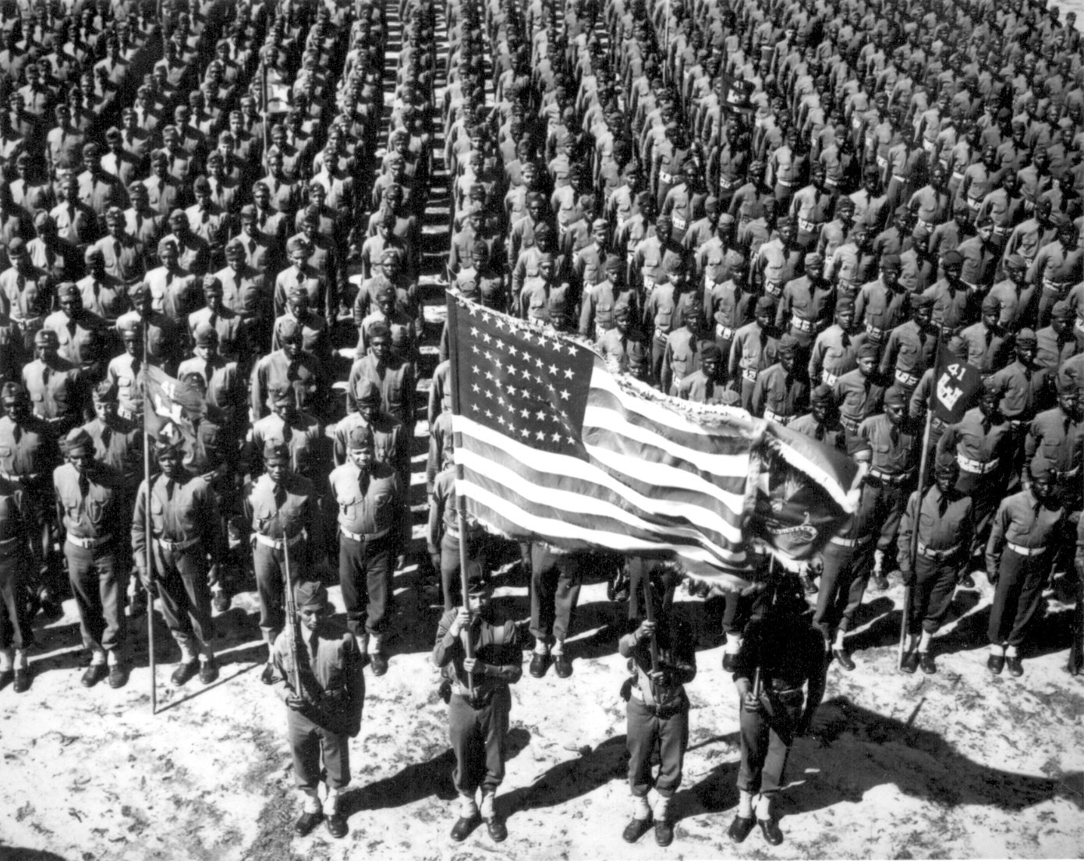
© 2014 Brain Wrinkles

Slide 18
WWI Ends
America’s entry into the war gave the Allies the extra power they needed to defeat the Central Powers.
In 1918, American troops fought the final battles of WWI.
In November 11, 1918, the Central Powers surrendered to the Allies.
© 2014 Brain Wrinkles

Slide 19
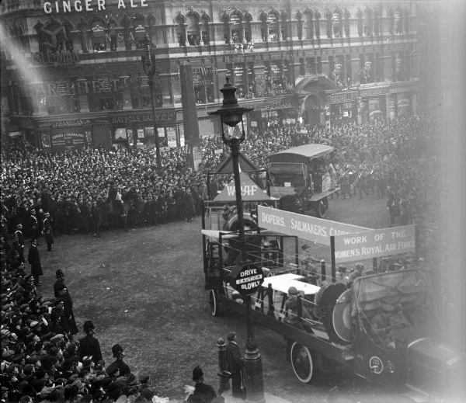
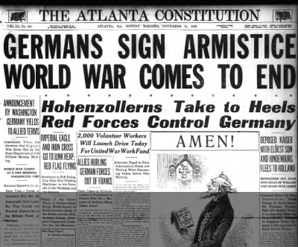
Celebrating the End of WWI
© 2014 Brain Wrinkles

Slide 20
Treaty of Versailles
In June 1919, leaders from countries involved in the war met in a French palace called Versailles to write a treaty for WWI.
The treaty outlined the terms of the winners and what they expected of the losing countries.
The Allied Powers dictated the treaty to Germany—it did not have a say in the terms.
© 2014 Brain Wrinkles

Slide 21
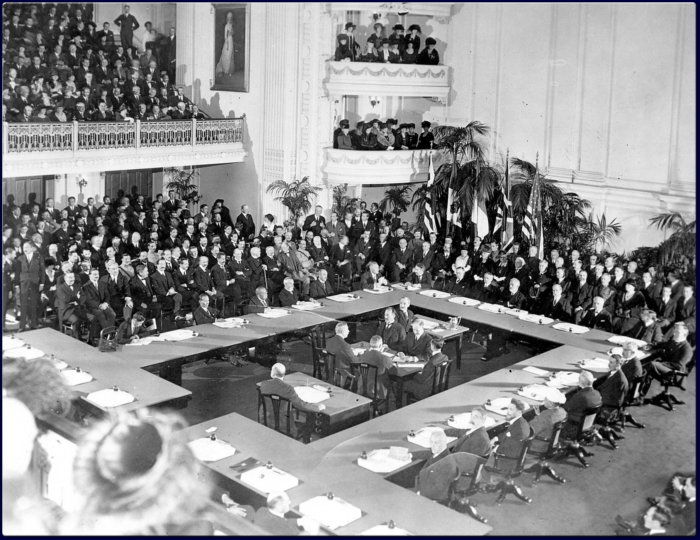
© 2014 Brain Wrinkles

Slide 22
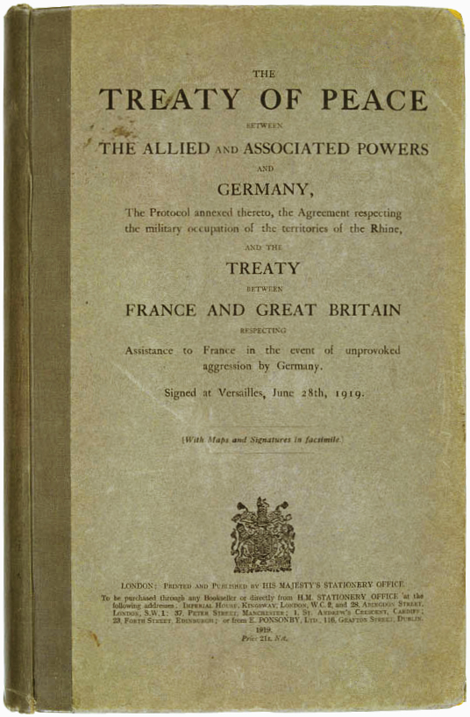
Treaty of Versailles
(English Version)
June 28th, 1919
© 2014 Brain Wrinkles

Slide 23
Reparations
Germany had to pay $33 billion in reparations to the allies.
Paying these reparations was nearly impossible because the war had left Germany’s economy bankrupt.
© 2014 Brain Wrinkles

Slide 24
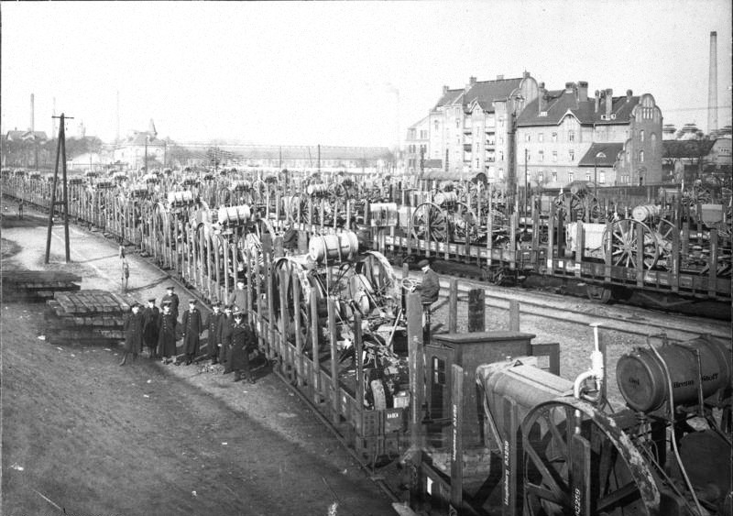
German Trains Loaded with Cargo to Make Reparation Payments
© 2014 Brain Wrinkles

Slide 25
Land
The Allies redrew the map of Europe.
The treaty took one million square miles of land from Germany.
Germany also lost its colonies.
New countries were created from some of this land.
© 2014 Brain Wrinkles

Slide 26
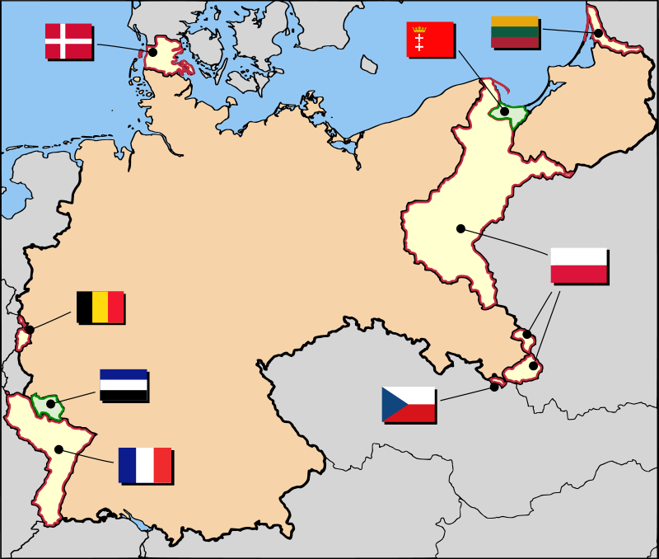
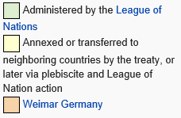
Germany After Versailles
© 2014 Brain Wrinkles

Slide 27
Militaryy
Germany had to disarm its military.
The army was cut to just 100,000 men and the navy could only have 6 battleships.
They were not allowed to make any new planes, tanks, or submarines.
Germany could not make or export any new weapons.
© 2014 Brain Wrinkles

Slide 28
Government
Germany’s government had to accept the blame for the war.
The Allies put a new government in place, but the citizens didn’t support it.
The people were unhappy and protested against the government because economic conditions were not improving.
© 2014 Brain Wrinkles

Slide 29
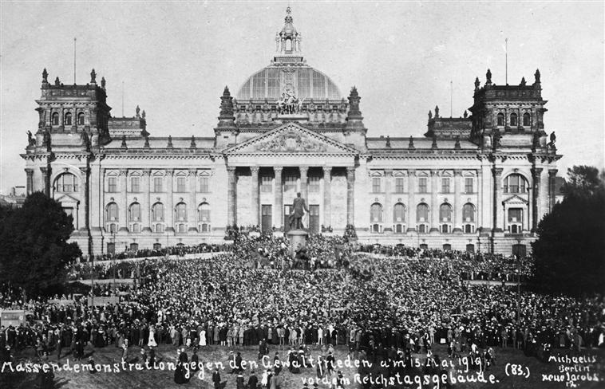
Germans Protesting the Treaty of Versailles
© 2014 Brain Wrinkles

Slide 30
Depression
World War I had left Germany’s economy in ruins.
The war, along with the Treaty of Versailles, caused Germany to go through an economic depression.
People lost their jobs and could not find new ones.
© 2014 Brain Wrinkles

Slide 31
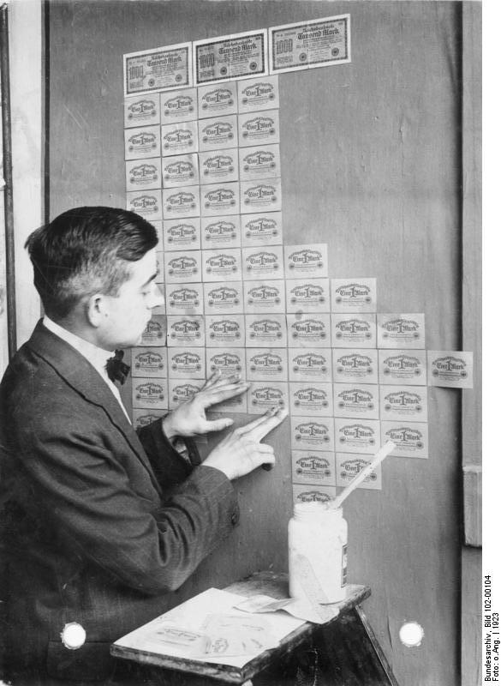
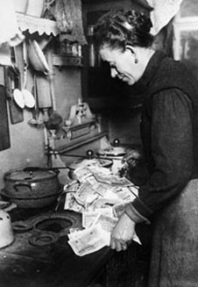
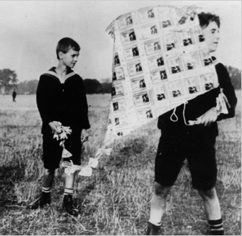
By 1923, German money had lost so much value that it was used as kites, wallpaper, and to start fires.
© 2014 Brain Wrinkles

Slide 32
What Next?
People who could not find jobs joined the Communist and National Socialist parties.
The National Socialist Party’s leader, Adolf Hitler, was gaining more and more power.
Many Germans were also still mad at the terms of the Treaty of Versailles.
Some began calling for revenge…
© 2014 Brain Wrinkles

Slide 33
Excerpt from a Germany Newspaper on the Day the Treaty of Versailles was Signed:
“Today in the Hall of Mirrors of Versailles the disgraceful Treaty is being signed.
Do not forget it. The German people will press forward to reconquer the place among nations to which we deserve. Then will come revenge for the shame of 1919.”
© 2014 Brain Wrinkles

Slide 34
SS5H4b
Post-War
America
© 2014 Brain Wrinkles

Slide 35
Good Times
Many Americans were shocked by the horrors of World War I.
They decided to change their way of life in the 1920s.
Most wanted to live for the present and enjoy life before something bad happened again.
Americans had more leisure time to do what they enjoyed.
© 2014 Brain Wrinkles

Slide 36
Baseball
Organized sports became more popular.
Americans loved baseball and baseball players became national heroes.
People followed every move of Babe Ruth, the greatest baseball player in the 1920s.
© 2014 Brain Wrinkles

Slide 37
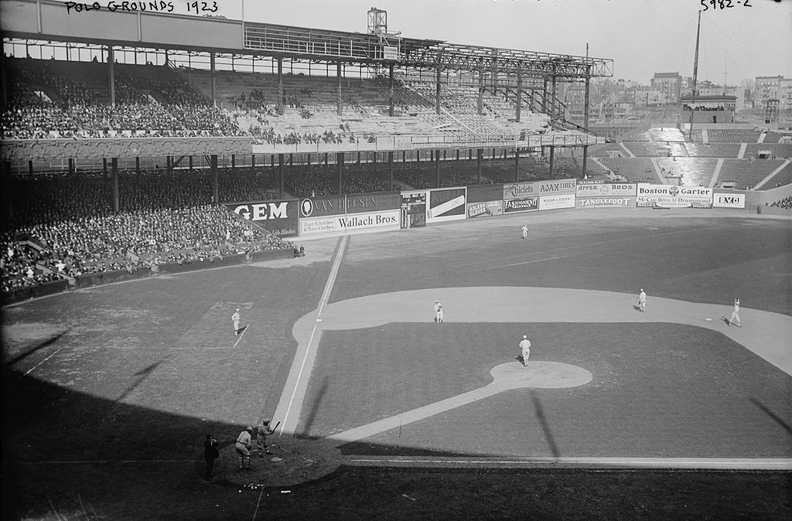
Polo Grounds, NYC
1923
© 2014 Brain Wrinkles

Slide 38
Babe Ruth
Babe Ruth was very talented and he made the game exciting.
In his 15 seasons with the NY Yankees, the team won 4 World Series championships, and Ruth set many hitting records.
Many people loved to listen to games on their new radios, and baseball became the most popular sport during the 1920s.
© 2014 Brain Wrinkles

Slide 39
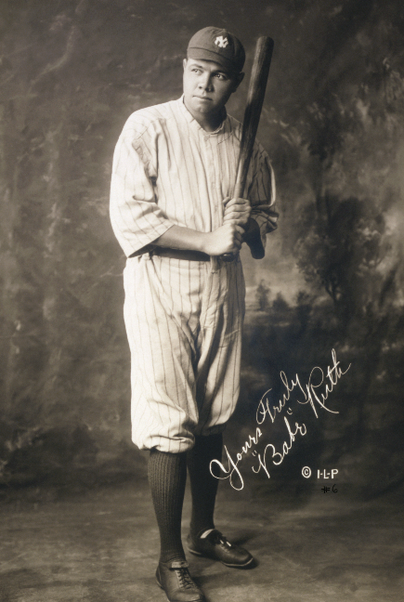
Babe Ruth
in a Yankees Uniform
1920
© 2014 Brain Wrinkles

Slide 40
Jazz Age
The 1920s in America were known as the Jazz Age, or the “Roaring Twenties”.
Americans enjoyed baseball, dancing, listening to the radio, and fun new music called jazz.
Jazz music developed among African Americans in the South, and quickly became popular all over the US.
Its popularity quickly spread to America’s biggest cities.
© 2014 Brain Wrinkles

Slide 41
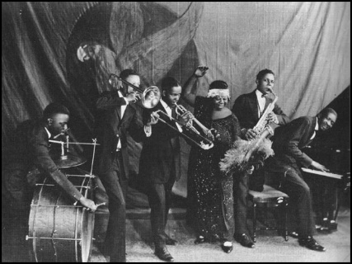
Ma Rainey & her Georgia Jazz Band 1924
© 2014 Brain Wrinkles

Slide 42
Louis Armstrong
Louis Armstrong, an African American musician from New Orleans, made a big impact in the 1920s.
He played the trumpet, cornet, and he sang.
Armstrong rose from poverty to become a legend in jazz.
© 2014 Brain Wrinkles

Slide 43
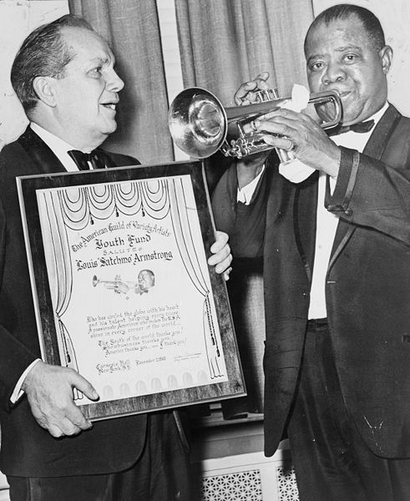
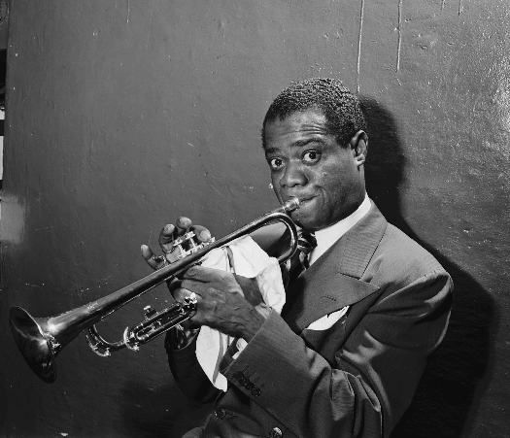
Louis Armstrong
© 2014 Brain Wrinkles

Slide 44
Harlem Renaissance
Many African Americans moved into cities in the 1920s, especially into New York.
African Americans made the Harlem section of New York their home.
A cultural movement known as the Harlem Renaissance was started when African American artists and writers expressed their talents.
It focused on literature, music, theater, art, and politics.
© 2014 Brain Wrinkles

Slide 45
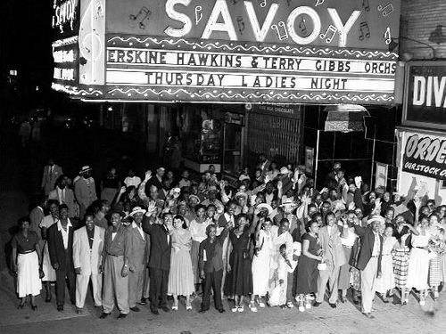
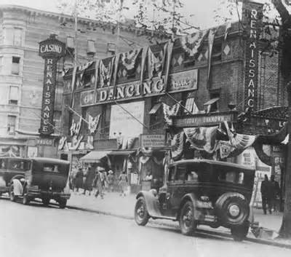
© 2014 Brain Wrinkles

Slide 46
Langston Hughes
Langston Hughes was one of the leaders of the Harlem Renaissance.
He wrote more than 60 books, including poems, novels, short stories, plays, children's poetry, musicals, operas, and autobiographies.
© 2014 Brain Wrinkles

Slide 47
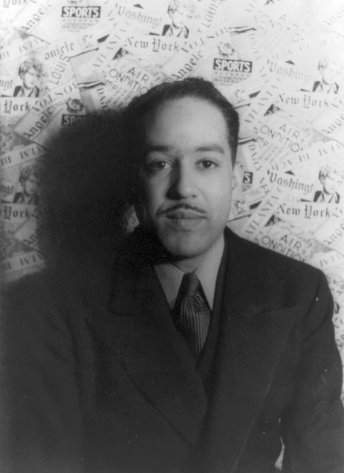
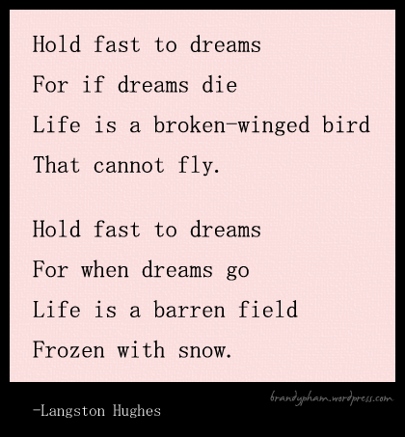
© 2014 Brain Wrinkles

Slide 48
Langston Hughes
Hughes wrote from his own experiences and combined African and American culture in his work.
His technique involved using jazz rhythms and dialects.
This helped readers understand the life of African Americans in the big cities during the 1920s.
© 2014 Brain Wrinkles

Slide 49
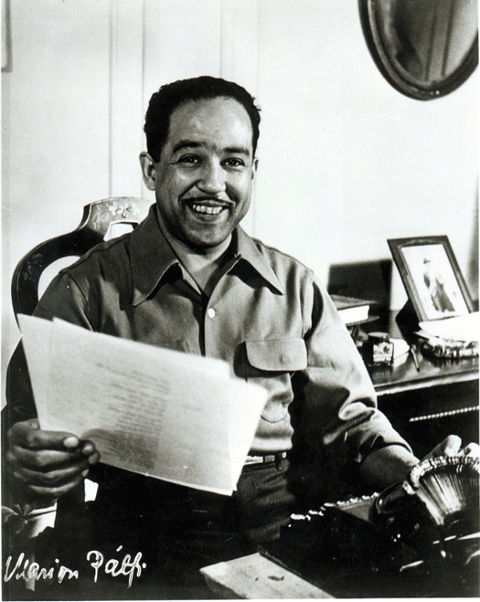
James Langston Hughes
1902-1967
© 2014 Brain Wrinkles

Slide 50
Economic Boom
After World War I, there was a boom in the American economy.
America had become the richest country in the world.
Factories stopped making war supplies and were now producing goods like radios and cars.
© 2014 Brain Wrinkles

Slide 51
Henry Ford
Henry Ford did not invent the automobile, but his assembly-line innovations made it possible to sell cars cheaply.
When Ford installed his assembly line, each worker on the line became a specialist.
One worker bolted on 1 wheel on each car as it moved along the line.
He worked faster than if he had to move around the car bolting on all the wheels.
© 2014 Brain Wrinkles

Slide 52
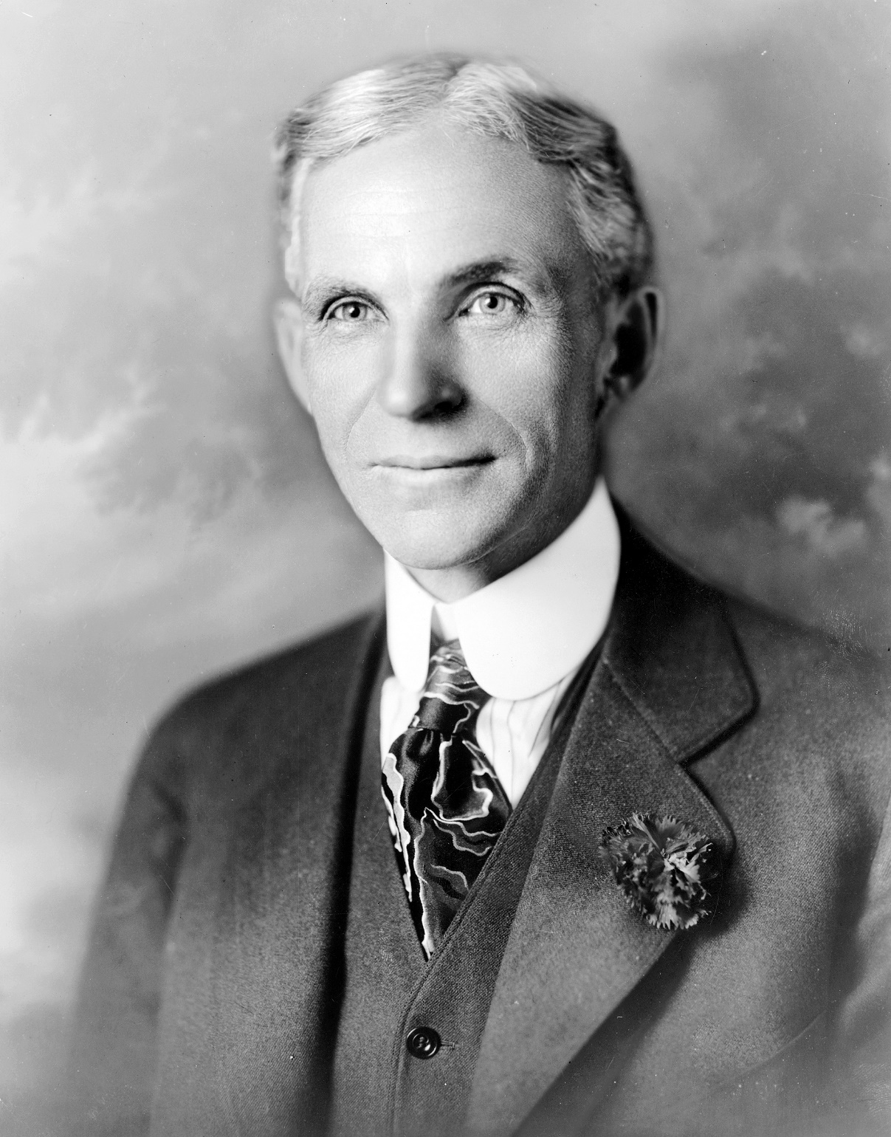
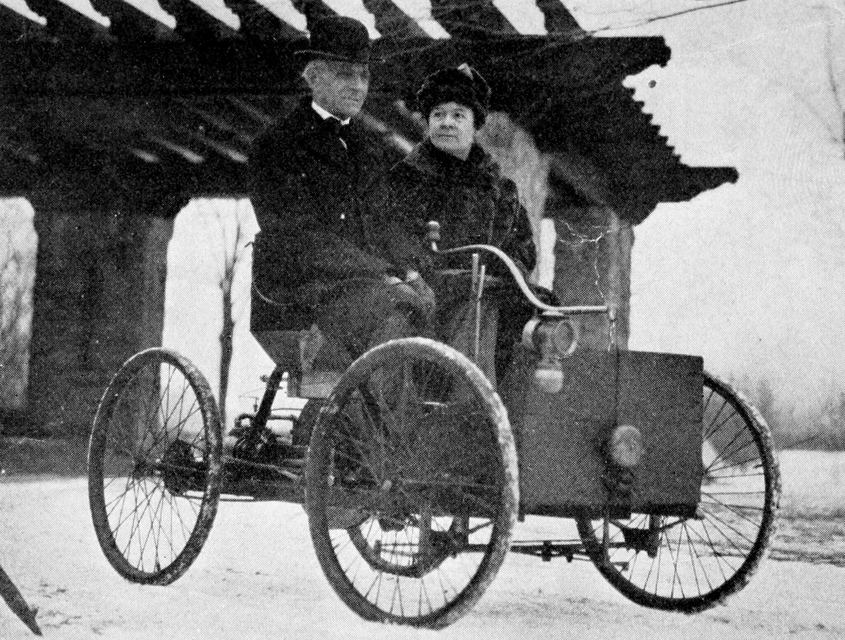
Henry Ford & Wife in his First Automobile – the Quadricycle
© 2014 Brain Wrinkles

Slide 53
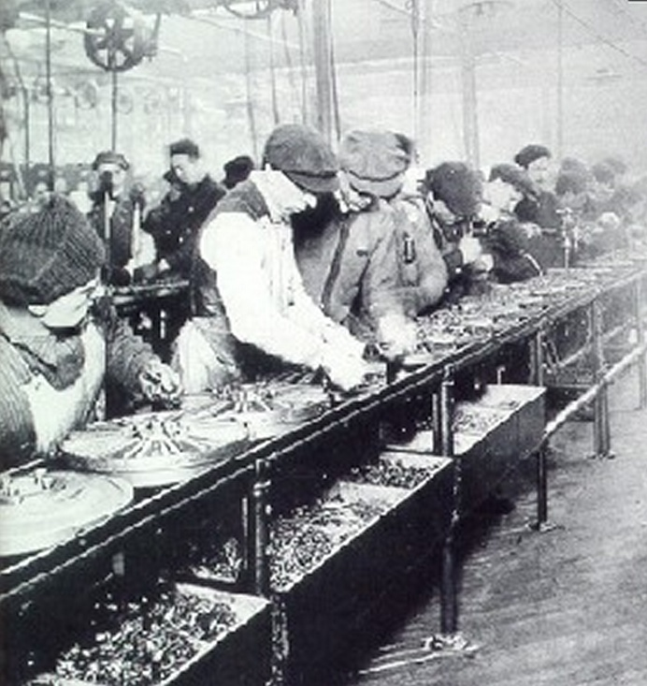
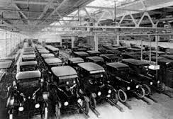
Ford Assembly Line 1913
© 2014 Brain Wrinkles

Slide 54
Henry Ford
This increased productivity and meant that Ford produced its cars at a lower cost and could sell them at a lower price.
As a result, more people could buy cars.
Ford’s mass production of the automobile resulted in more jobs, greater mobility, movement to suburban areas, and the growth of transportation-related industries.
© 2014 Brain Wrinkles

Slide 55
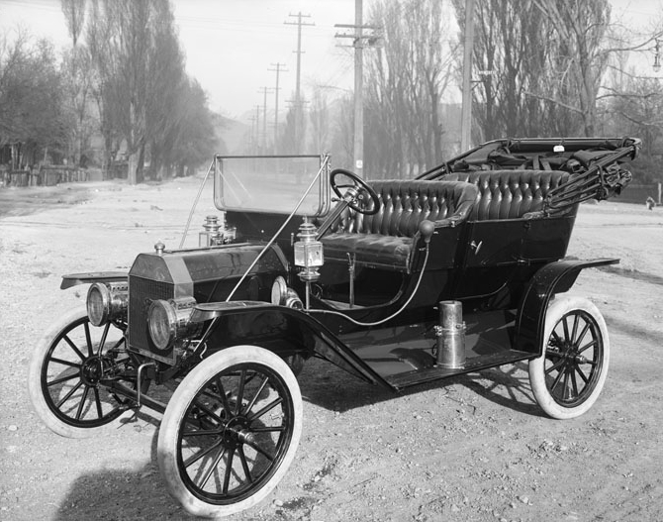
Henry Ford’s first automobile was the Model T. In the first year it was produced, more than 10,000 were sold.
© 2014 Brain Wrinkles

Slide 56
Charles Lindbergh
In 1927, Charles Lindbergh became the first man to fly in an airplane across the Atlantic Ocean.
He traveled from New York to Paris in a single-engine airplane named the “Spirit of St. Louis”.
His flight created interest in airplanes and air travel, and more people started flying as a result.
© 2014 Brain Wrinkles

Slide 57
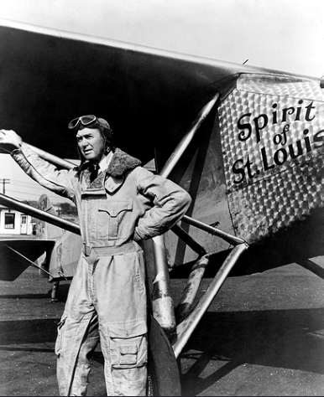
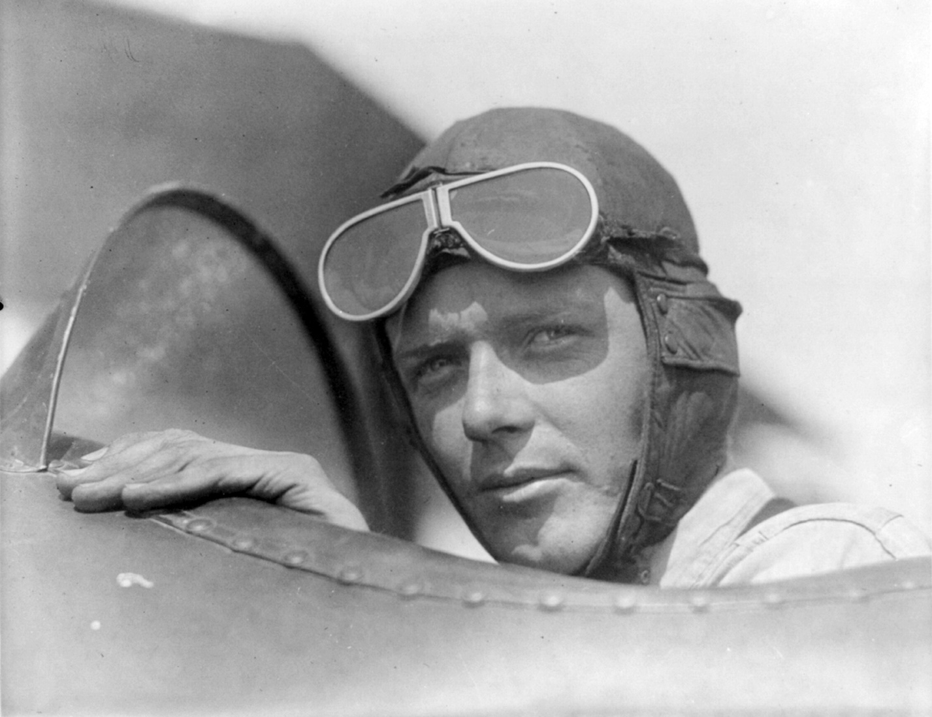
Charles Lindbergh
© 2014 Brain Wrinkles

Slide 58
Charles Lindbergh
He became famous promoting air travel, and in March 1, 1932 his infant son was kidnapped and murdered.
The kidnapping was called the crime of the century and was the first time a ransom was given and the person was killed instead of returned. The baby was found dead in the woods on March 12, not far from the family home.
Kidnapping became a federal crime after this event. The kidnapper Richard Hauptmann was caught and executed.
© 2014 Brain Wrinkles

Slide 59
End of WWI
WWI is often called “The War to End All Wars”
The Industrial Revolution was spurred into “high gear” because of the demand that the war placed on new technology.
© 2014 Brain Wrinkles

